Slide 1

Presentation Title : LDAP – Lightweight Directory Access Protocol Course Title : Computer Networks Course Code : ICT-3201
Presented By: | Supervised By:
Hossain Mohammad Abujar ID:IT22056 Dept. of ICT, MBSTU | Dr. Nazrul Islam Associate Professor Dept. of ICT, MBSTU

Slide 2
Agenda
Introduction to LDAP
Directory Basics
LDAP Architecture & Model
LDAP Operations
Data Representation & Schema
Authentication & Security
LDAP vs Active Directory
Advantages & Use Cases

Slide 3
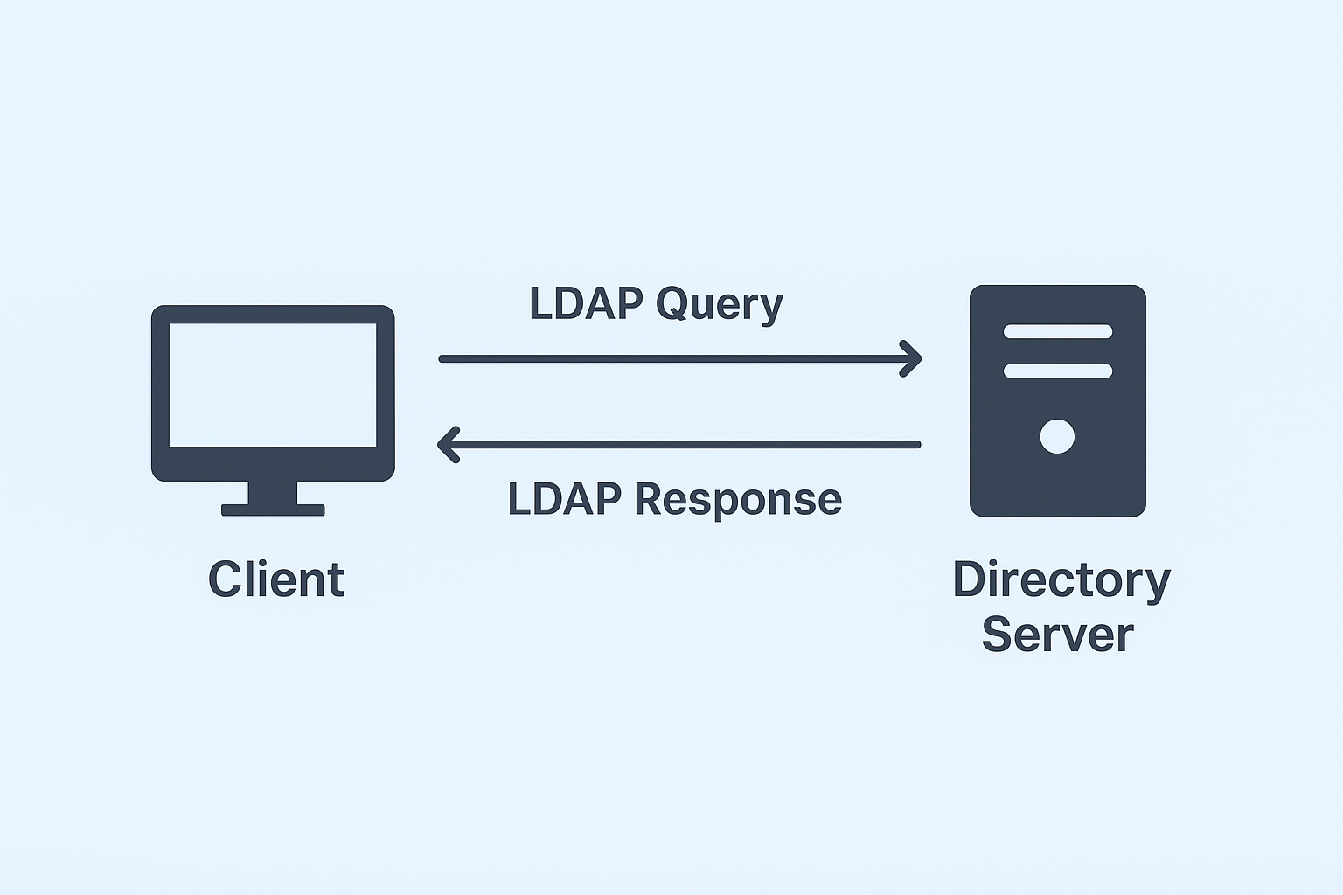
Introduction to LDAP
LDAP (Lightweight Directory Access Protocol) is a protocol used to access and manage directory services across networks.
It allows clients to search, add, modify, and delete entries in a directory.
Directories are hierarchical databases storing information such as: Users and their credentials, Devices and network resources, Applications and groups.
LDAP is widely used in enterprise authentication and authorization, email servers, and centralized resource management.
It is a standardized protocol, ensuring compatibility across multiple directory services like OpenLDAP, Microsoft Active Directory, and 389 Directory Server.

Slide 4
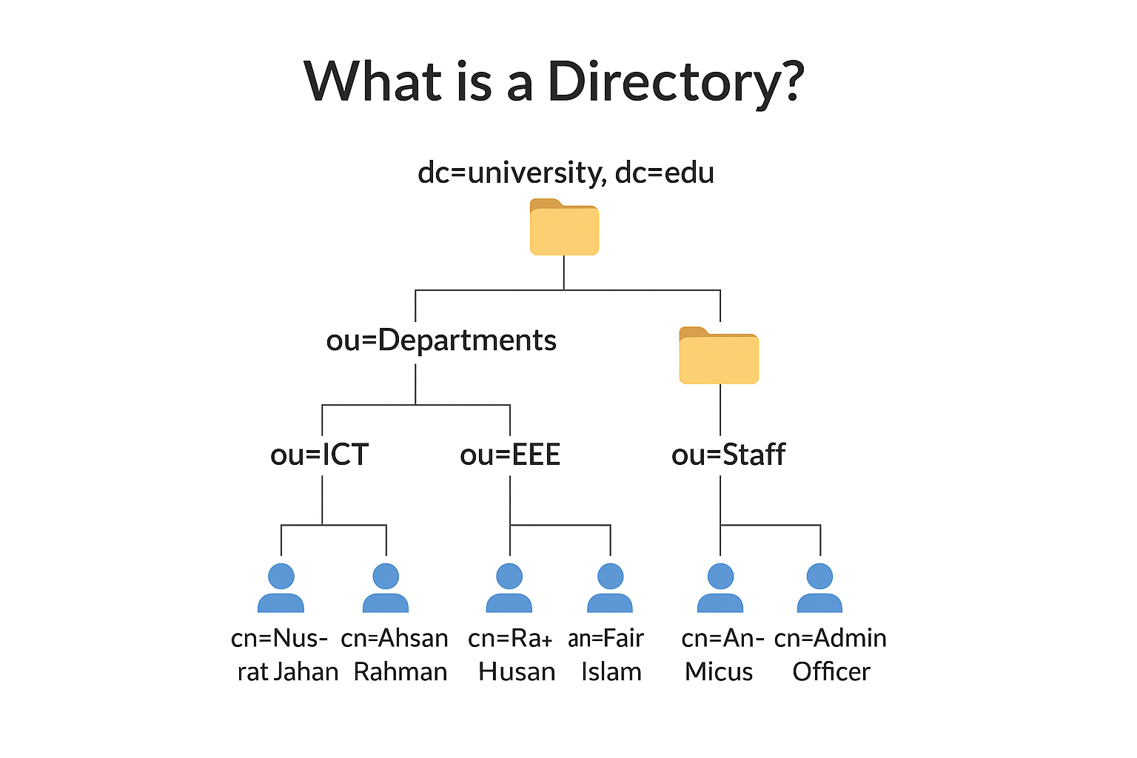
What is a Directory?
A Directory is a specialized database that stores information about users, computers, groups, printers, and other resources in a hierarchical structure.
Each item in the directory is called an entry, which contains attributes describing that object (e.g., name, email, phone).
The directory structure is like an organization chart or a family tree — starting from a root and branching into units (departments, users, etc.).
LDAP acts as the bridge between clients and this directory system.

Slide 5
What is a Directory? (Con….)
Example Explanation:
Think of your university’s system:
ICT Department
Teachers
Md. Rahman
Students
ID: 20201001
Name: Ahsan Rahman
Each of these is a directory entry with specific attributes.
LDAP Directory Tree
dc=university,dc=edu
├── ou=Departments
│ ├── ou=ICT
│ │ ├── cn=Nusrat Jahan
│ │ ├── cn=Ahsan Rahman
│ │ └── cn=Rafiul Hasan
│ └── ou=EEE
│ ├── cn=Fariha Islam
│ └── cn=Rahim Ahmed
└── ou=Staff
└── cn=Admin Officer

Slide 6
LDAP Architecture & Model
1. LDAP Architecture:
LDAP follows a Client–Server Model.
Clients send requests (Search, Add, Modify, Delete) to the Directory Server.
Directory Server maintains directory data organized as a Directory Information Tree (DIT).
The DIT represents data hierarchically (root → branches → leaves).
Communication happens via TCP/IP, using:
Port 389 → LDAP (non-secure)
Port 636 → LDAPS (secure, over SSL/TLS)
Schema defines what kind of entries and attributes the directory can hold.

Slide 7
LDAP Architecture & Model(Con….)
2. LDAP Information & Functional Model:
Information Model:
Describes how data is represented.
Data stored as entries, each having a Distinguished Name (DN) and attributes.
Example:
dn: cn=John Doe, ou=ICT, dc=university, dc=edu
cn: John Doe
mail: john.doe@university.edu
uid: jdoe

Slide 8
LDAP Architecture & Model(Con….)
Functional Model:
Defines what operations can be performed on the directory.
Common LDAP Operations:
1. Bind: Authenticate the user/client.
2. Search: Retrieve directory entries.
3. Compare: Check an attribute value.
4. Add/Delete/Modify: Manage directory entries.
5. Unbind: End the session.

Slide 9
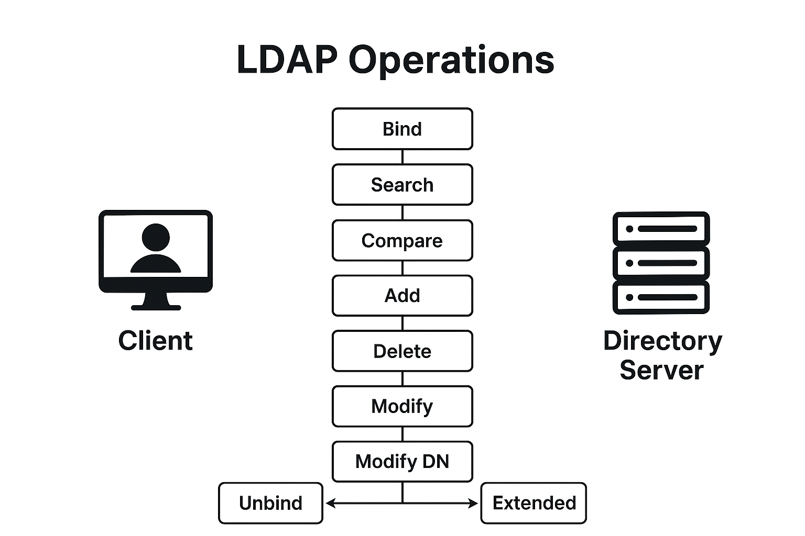
LDAP Operations
LDAP defines a set of operations that clients use to interact with the directory.
These operations are classified as basic, authentication, and update operations.
All operations are sent from the client to the directory server and processed via the LDAP protocol.

Slide 10
LDAP Operations(Con…)
There are ten basic types of operations in LDAP:
Bind Authenticate a user and change the identity of the client connection.
Search Retrieve entries that match a given set of criteria.
Compare Determine whether a specified entry has a particular attribute value.
Add Create a new entry in the directory.
Delete Remove an entry from the directory.
Modify Alter the content of an entry in the directory.
Modify DN Change the DN of an entry in the directory.
Unbind Close the connection to the directory server.
Abandon Request that the server stop processing a previously requested operation.
Extended Request some other type of processing that isn’t covered by one of the other operation types.

Slide 11
Data Representation & Schema
What is Data Representation in LDAP?
LDAP stores information in entries.
Each entry represents an object (like a user, group, or printer).
Entries are arranged hierarchically in the Directory Information Tree (DIT).
Each entry is uniquely identified by a Distinguished Name (DN).
2. Distinguished Name (DN)
DN = full path of an entry in the directory tree.
It uniquely identifies the location of an entry.

Slide 12
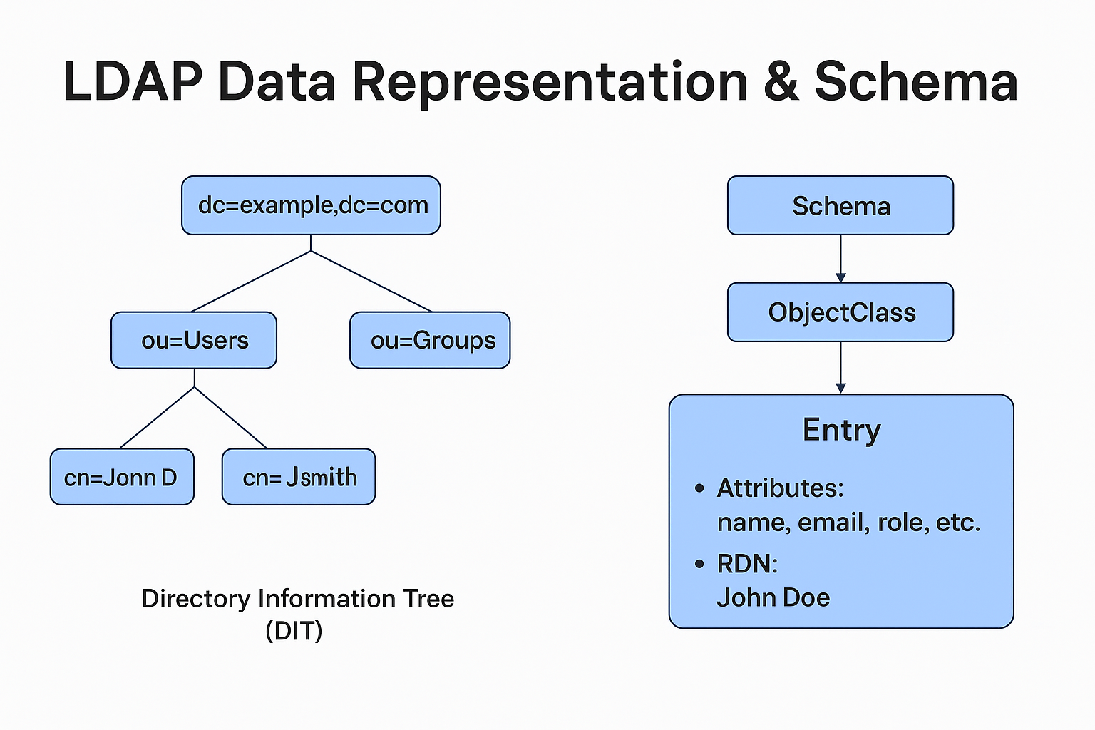
Data Representation & Schema(Con..)
3. Relative Distinguished Name (RDN)
RDN = part of the DN that uniquely identifies the entry within its parent.
4. Attributes
Each entry contains attributes — key-value pairs describing object properties.
5. Object Classes
Define what type of object an entry is and which attributes it can have.

Slide 13
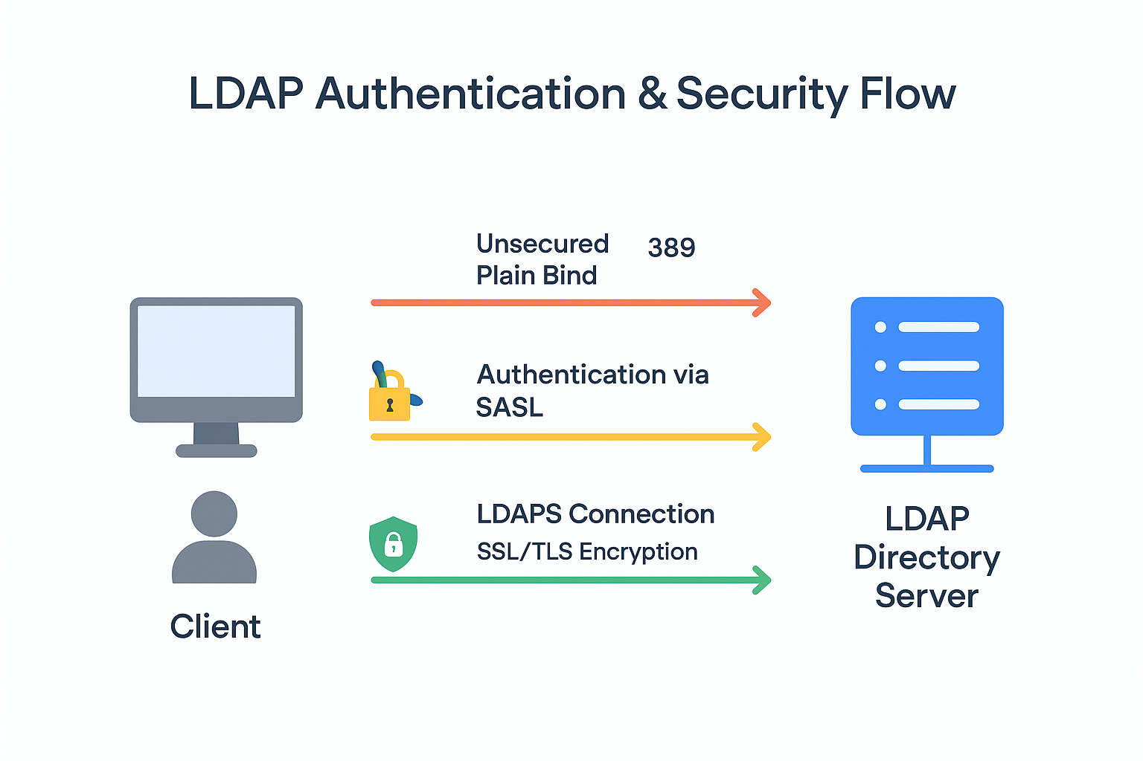
Authentication & Security
LDAP supports several authentication methods and security mechanisms to protect communication between clients and directory servers.

Slide 14
Authentication & Security(Con..)
Authentication Methods
a. Anonymous Bind
No credentials required.
Used only for public read-only access.
Not secure, often disabled in production environments.
b. Simple Bind
Client sends DN (Distinguished Name) and password in plaintext.
Used for basic authentication.
Vulnerable if not encrypted.

Slide 15
Authentication & Security(Con..)
c. SASL (Simple Authentication and Security Layer)
Framework for adding authentication using external mechanisms (e.g., Kerberos, DIGEST-MD5).
More flexible and secure than Simple Bind.
Security Mechanisms
a. LDAPS (LDAP over SSL/TLS)
Encrypts communication on port 636.
Provides confidentiality and integrity protection.

Slide 16
Authentication & Security(Con..)
b. StartTLS
Begins with a normal LDAP connection on port 389, then upgrades to a secure TLS connection.
More modern and flexible than LDAPS.
c. SSL/TLS Certificates
Used to verify the server’s identity and encrypt data.
Prevents man-in-the-middle attacks.

Slide 17
LDAP vs Active Directory
LDAP (Lightweight Directory Access Protocol) | Active Directory (AD)
An open, vendor-neutral protocol for accessing and maintaining distributed directory information services. | A Microsoft-developed directory service that uses LDAP as one of its access protocols.
(Type):Protocol (used to query and modify directory services) | (Type):Directory Service (built on LDAP, Kerberos, and other technologies)
Stores data in directory databases like OpenLDAP, ApacheDS, or 389 Directory Server | Stores data in a centralized database managed by Microsoft (NTDS.dit)
Supports Simple Bind, SASL, StartTLS, LDAPS | Uses LDAP for directory access and Kerberos for authentication
Highly customizable; admins can define object classes and attributes freely | Predefined schema, can be extended but more structured
Managed via command-line tools like ldapsearch, ldapadd, ldapmodify | Managed via GUI tools like Active Directory Users and Computers (ADUC) or PowerShell

Slide 18
Advantages & Use Cases
Advantages of LDAP
1. Lightweight & Efficient
Uses minimal bandwidth and resources.
Optimized for read-heavy directory access.
2. Open Standard Protocol
Not tied to any vendor.
Works across multiple platforms (Windows, Linux, macOS).
3. Centralized Management
Stores all user, group, and access information in one place.
Simplifies authentication and authorization.

Slide 19
Advantages & Use Cases(Con..)
4. Scalable & Extensible
Supports millions of entries.
Allows admins to define custom object classes and attributes.
5. Flexible Authentication Options
Supports anonymous, simple, and SASL authentication.
Easily integrates with SSL/TLS for secure communication.
6. Integration Capabilities
Works with email servers, intranet portals, VPNs, and enterprise apps.
Can be integrated with Microsoft AD, OpenLDAP, and other directory systems.

Slide 20
Advantages & Use Cases(Con..)
Use Cases of LDAP
Enterprise User Authentication Used by organizations to authenticate employees centrally — one password, multiple systems.
Email & Messaging Systems Mail servers like Postfix or Exchange use LDAP to look up user addresses.
Access Control for Applications Web apps and intranet portals use LDAP for user login and authorization checks.
Educational Institutions Universities use LDAP for managing student, teacher, and staff accounts in one unified system.
Network Device Management Routers, switches, and firewalls use LDAP for centralized admin authentication.

Slide 21


